Slide 1
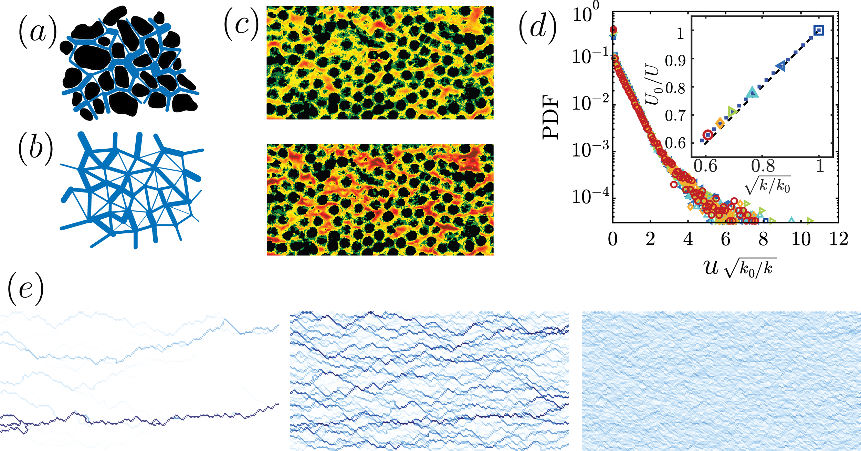
Dynamics of flow-networks in porous media
MRSEC
Understanding flow and transport of fluids and material in porous media is important for many industrial and environmental applications.
We model a porous medium as a network of pores connected with cylindrical tubes representing the pore-throats. Using this simplified model, we explain the experimentally observed exponential distribution of local fluid velocity in a disordered porous media.
Considering the evolution of the network in time, we find rich dynamics. Depending on the underlying constitutive law the system either becomes homogeneous over time or forms channels.
¹Ahmad Zareei, ¹Deng Pan, ¹Ariel Amir, ¹Dave Weitz, ²Shima Parsa
¹Harvard University, ²Rochester Institute of Technology
Pore-level flow velocity magnitude: (a) Cross-section of a porous media (sandstone) obtained using computerized tomography scan; (b) Schematic of a topologically random network; (c) Experimental results of fluid velocity in a porous media made of glass-beads before (top-row) and after polymer flow (bottom row) which results in changes in network structure; (d) Probability density function, PDF, of the magnitude of flow velocities normalized by the inverse square root of the permeability. Inset shows the linear relation between relative average velocity and the inverse square root of permeability; (e) different long-time behavior of a porous network depending on various erosion laws, changing from channeling instability (left) to homogenization (right) indicating the rich physics in a porous network system.
Notes:
<number>

